Slide 1
CS97: Introduction to Data Science
13: Application: Time Series, Epidemics, Financial Market
Instructor: Shichang Zhang
shichang@ucla.edu

Slide 2
How is everyone doing?
You are taking a college-level (upper-division) class!
You are almost there.
Be proud of yourself.

Slide 3
Announcements
This afternoon: research seminar
Time: 1 pm - 2:30 pm,
Location: Boelter Hall 3400
Speaker: Prof. Jason Cong
Students from CS 30 (CSSI Introductory Level) will join us
Snacks will be provided
Back to normal discussion/lab in your discussion classroom (midterm review)

Slide 4
Seminar: Automating Chip Designs and Quantum Computing
Abstract: Integrated circuits (ICs) or chips powered the rapid growth in computing, communication, and artifical intelligence in the past a few decades. They are widely used in our daily lives, from mobile devices, to home appliances, to automobiles, and to cloud computing. Chip design used to be considered a “black art” and needs long training time and extensive experience. The goal of our research is to make IC design easy, so that every colleague or high-school student interested in computing can design his/her own favorite IC by simply writing a high-level computer program, such as a C or Python program. In this talk, I shall highlight our progress in automated chip designs using a combination of techniques from high-level synthesis and machine learning. In fact, machine learning techniques are used for programming quantum computers and I shall highlight some recent progress.
Speaker Bio: Jason Cong is the Volgenau Chair for Engineering Excellence Professor at the UCLA Computer Science Department (and a former department chair), with joint appointment from the Electrical and Computer Engineering Department. He is the director of Center for Domain-Specific Computing (CDSC) and the director of VLSI Architecture, Synthesis, and Technology (VAST) Laboratory. Dr. Cong’s research interests include novel architectures and compilation for customizable computing, synthesis of VLSI circuits and systems, and quantum computing. He has over 500 publications in these areas, including 17 best paper awards, and 4 papers in the FPGA and Reconfigurable Computing Hall of Fame. He and his former students co-founded AutoESL, which developed the most widely used high-level synthesis tool for FPGAs (renamed to Vivado HLS after Xilinx’s acquisition). He was elected to an IEEE Fellow in 2000, ACM Fellow in 2008, the National Academy of Engineering in 2017, and the National Academy of Inventors in 2020. He is the recipient of the 2022 IEEE Robert Noyce Medal for fundamental contributions to electronic design automation and FPGA design methods.

Slide 5
Announcements
Tuesday afternoon: midterm exam
Time: 1:00 pm - 3:00 pm,
Location: Boelter Hall 3400
Topics: everything up to clustering (first two weeks)
Cheat sheet: letter size, double-sided, hand-written
Calculator: only simple calculators are allowed (no TI-83, TI-84, etc), leave your answers as fractions is totally fine, formulas and required values will be provided for your convenience, e.g., log₂5
Question types: T/F, multiple choice with a single correct answer, multiple choice with multiple correct answers, writing/calculation questions

Slide 6
So far
Models and algorithms
Supervised
Linear regression
KNN
…
Unsupervised
K-Means
…
All on tabular (vector) data

Slide 7
Today’s Roadmap
Time series data
Epidemics Modeling
Introduction: COVID-19 Case Prediction
Time Series Prediction: Problem Definition
Data Acquirement and Visualization
Model Description
Auto-Regressive Modeling
SIR for epidemic Modeling
Visualization of Results
Financial Market Modeling
Financial Time Series
Mechanism-driven vs. Data-Driven methods
Laws of Physics vs. Machine Learning
The Financial Epidemics and Market Contagion

Slide 8


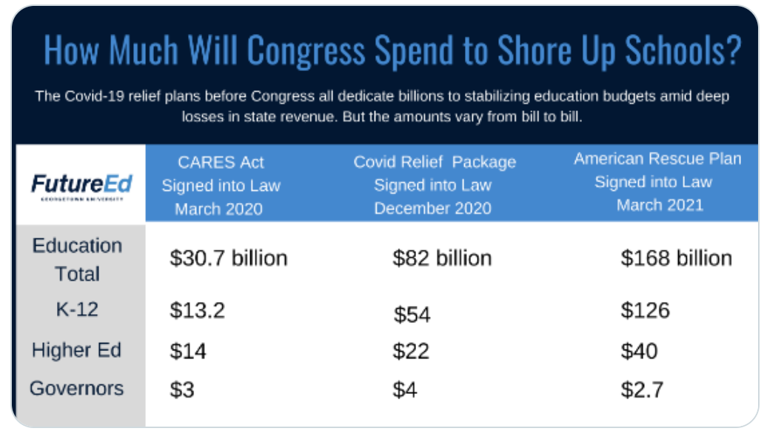
Introduction: COVID-19 Case Prediction
The rapid spread of COVID-19 has had and continues to have a significant impact on society.

Slide 9
Introduction: COVID-19 Prediction
Accurately forecasting the progression of COVID-19 can help people monitor and take actions to combat it, e.g. “close border” , “physical distancing” policies.
Examples
Predict the daily cumulative confirmed cases/deaths for each state in the U.S. in the next week/month, etc.

Slide 10
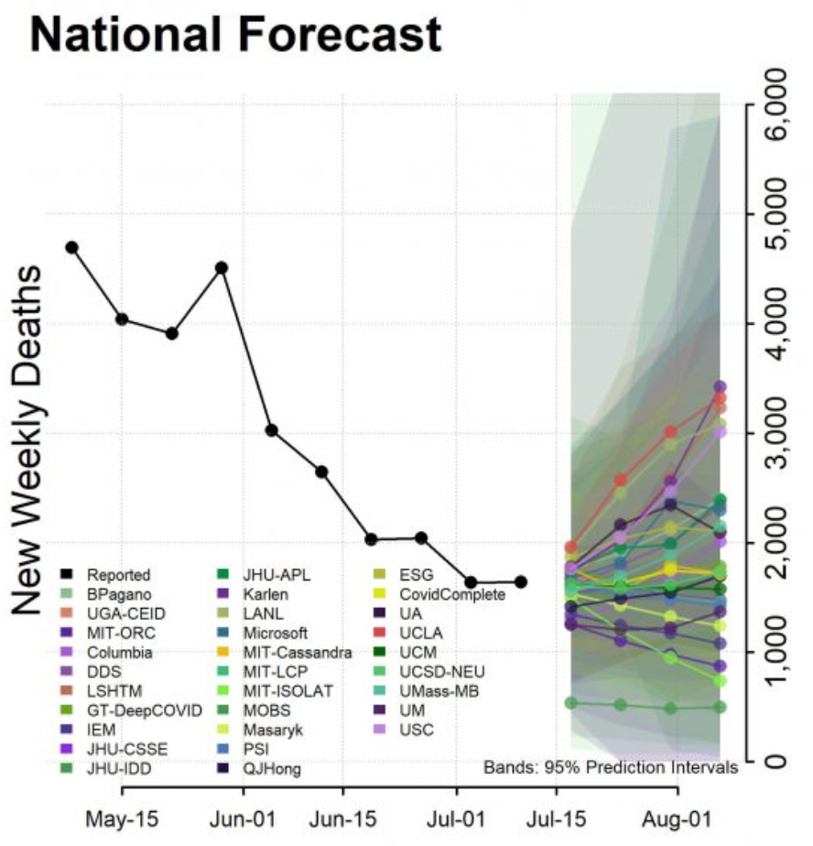
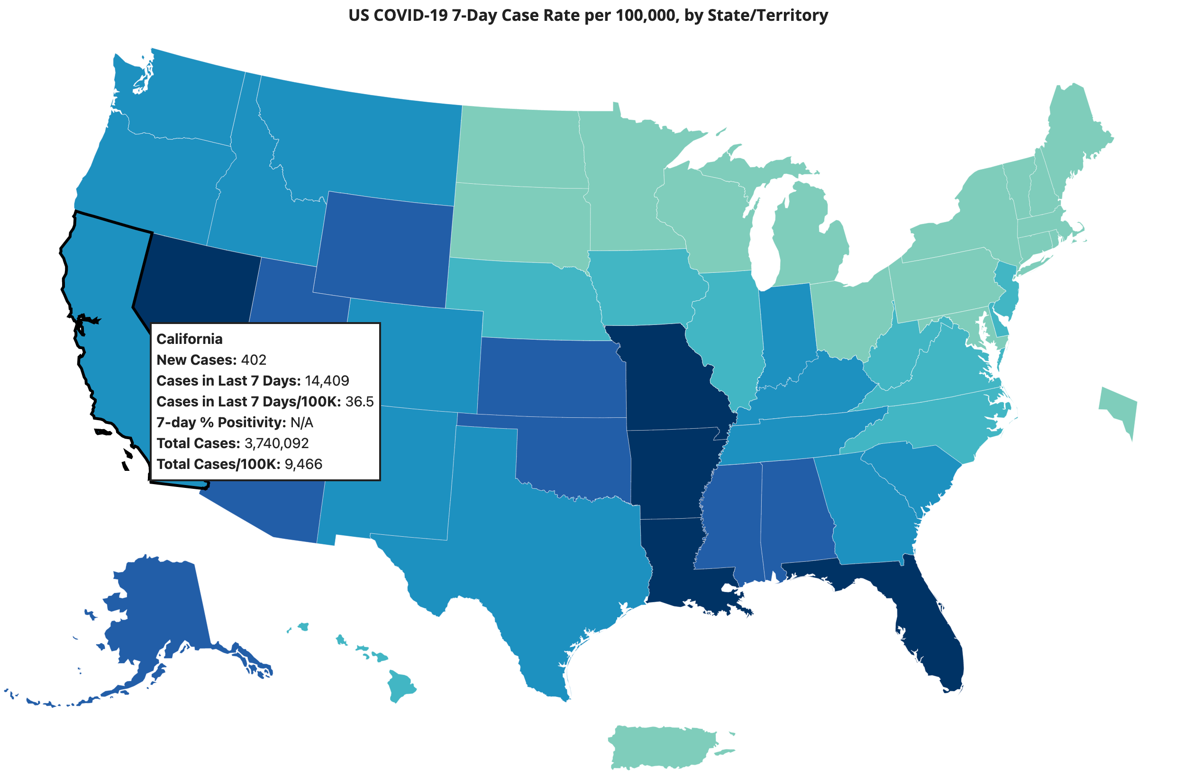
Introduction: COVID-19 Prediction
Various methods have been developed by different institutions and are aggregated at CDC weekly ^{[1]}.
[1] https://www.cdc.gov/coronavirus/2019-ncov/science/forecasting/forecasting-us.html
Observed periods
Predict periods

Slide 11
Introduction: COVID-19 Prediction
These methods all try to use the past to predict the future and differs in:
What to predict:
What are the response variables: daily confirmed cases, daily new cases, daily confirmed deaths, daily new deaths, etc.
How long they would like to predict: one week ahead, two weeks ahead, etc.
What’s the format of the prediction results: point or quantile (with uncertainty) prediction.

Slide 12
Introduction: COVID-19 Prediction
These methods all try to use the past to predict the future and differs in:
How to predict:
What are the data inputs (features/predictors) that they use: the past daily deaths/case count, hospitalization rate, population flow in/between locations, etc.
Models: autoregressive model, epidemic models, etc.

Slide 13
Introduction: COVID-19 Prediction
The detailed prediction results for these methods can be found here.
An example:

Slide 14
Roadmap
Introduction
Problem Definition
Data Acquirement and Visualization
Model Description & Evaluation
Visualization of Results

Slide 15
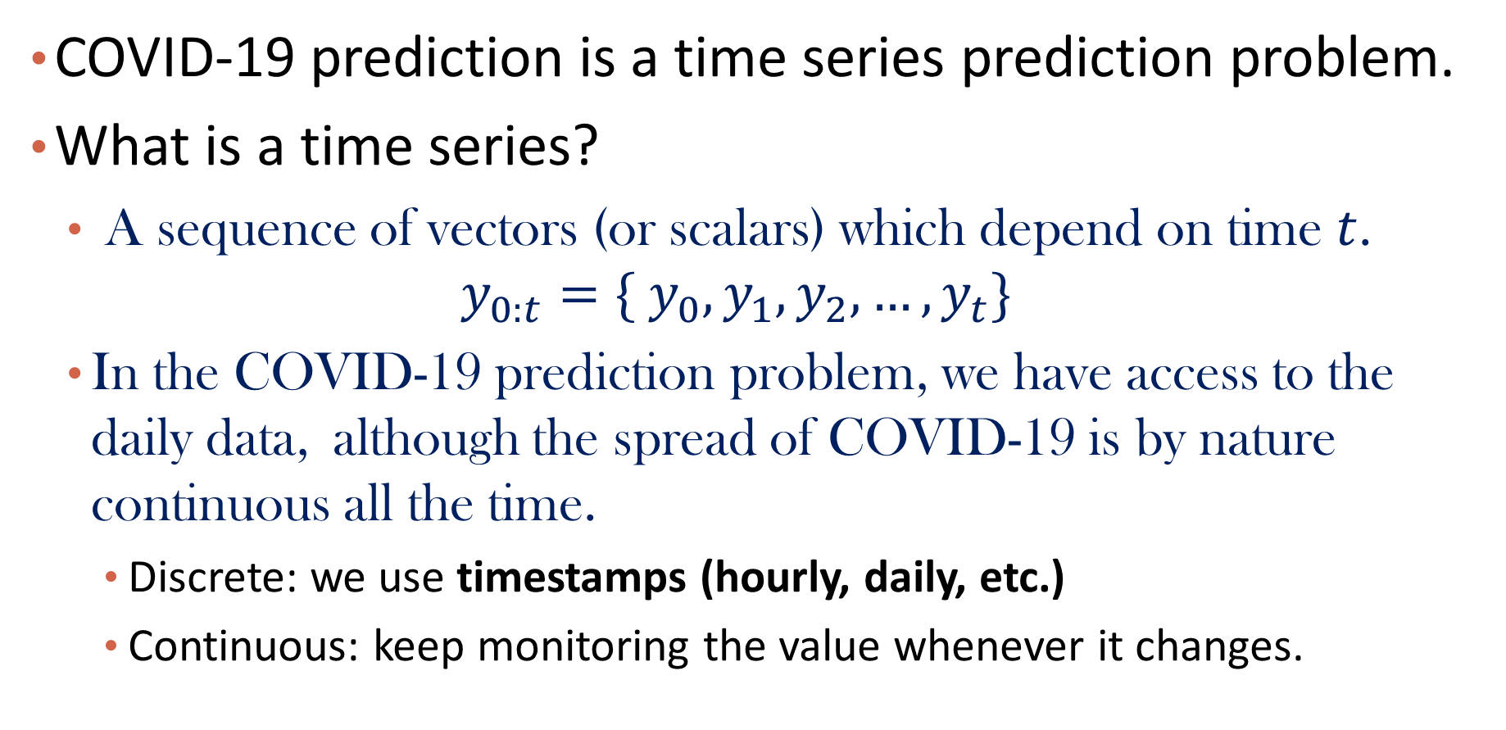
Problem Definition
COVID-19 prediction is a time series prediction problem.
What is a time series?
A sequence of vectors (or scalars) which depend on time $t$.
$$y_{0:t}=\{ y_{0},y_{1},y_{2},…,y_{t}\}$$
In the COVID-19 prediction problem, we have access to the daily data, although the spread of COVID-19 is by nature continuous all the time.
Discrete: we use timestamps (hourly, daily, etc.)
Continuous: keep monitoring the value whenever it changes.

Slide 16
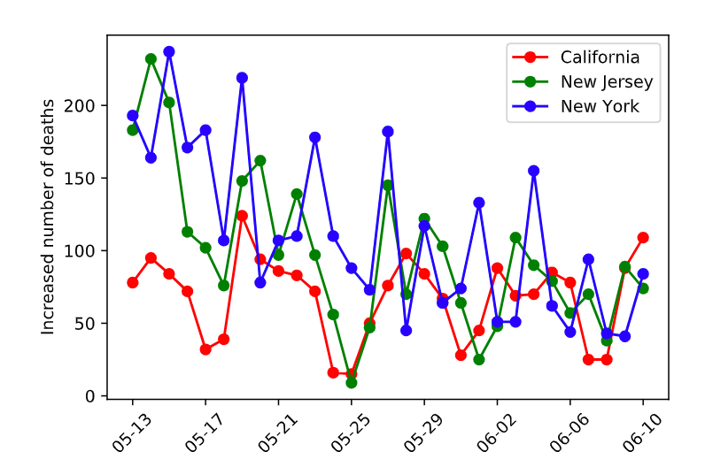
Problem Definition
Example: the daily confirmed deaths/cases at a location
COVID-19 death count time series for 3 different states.

Slide 17

Problem Definition
To predict the number of cases and deaths for a location
The historical values which are respond variables
Additional predictors e.g. hospitalization rate, testing rate, population etc., which can be static like population or dynamic like daily testing rate.
$$y_{0:t}=\{ y_{0},y_{1},y_{2},…,y_{t}\}$$
$$x_{0:t}=\{ x_{0},x_{1},x_{2},…{,x}_{t}\}$$

Slide 18
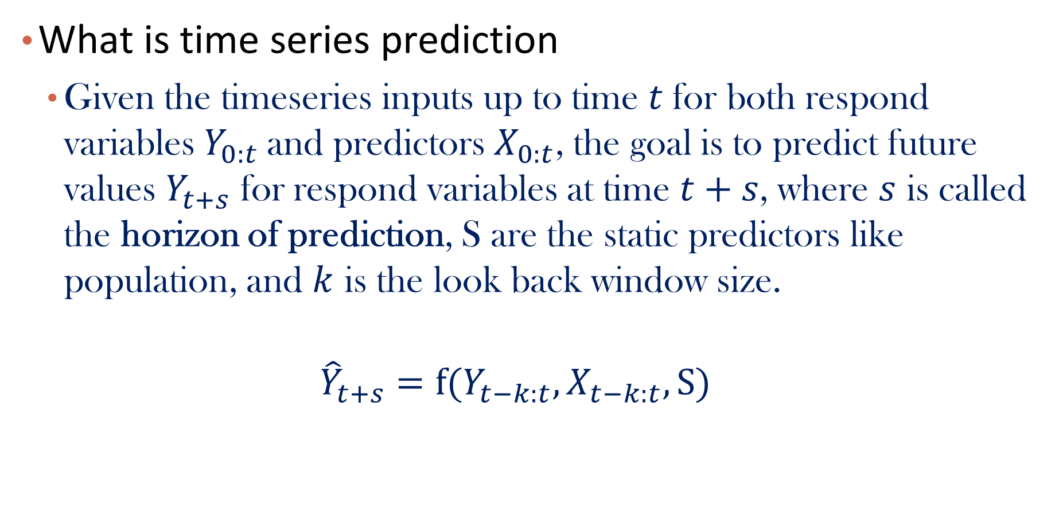
Problem Definition
What is time series prediction
Given the timeseries inputs up to time $t$for both respond variables $Y_{0:t}$and predictors${ X}_{0:t}$, the goal is to predict future values $Y_{t+s}$ for respond variables at time $t+s$, where $s$ is called the horizon of prediction, S are the static predictors like population, and $k$ is the look back window size.
$${\hat{Y}}_{t+s}=f(Y_{t−k:t},X_{t−k:t},S)$$

Slide 19
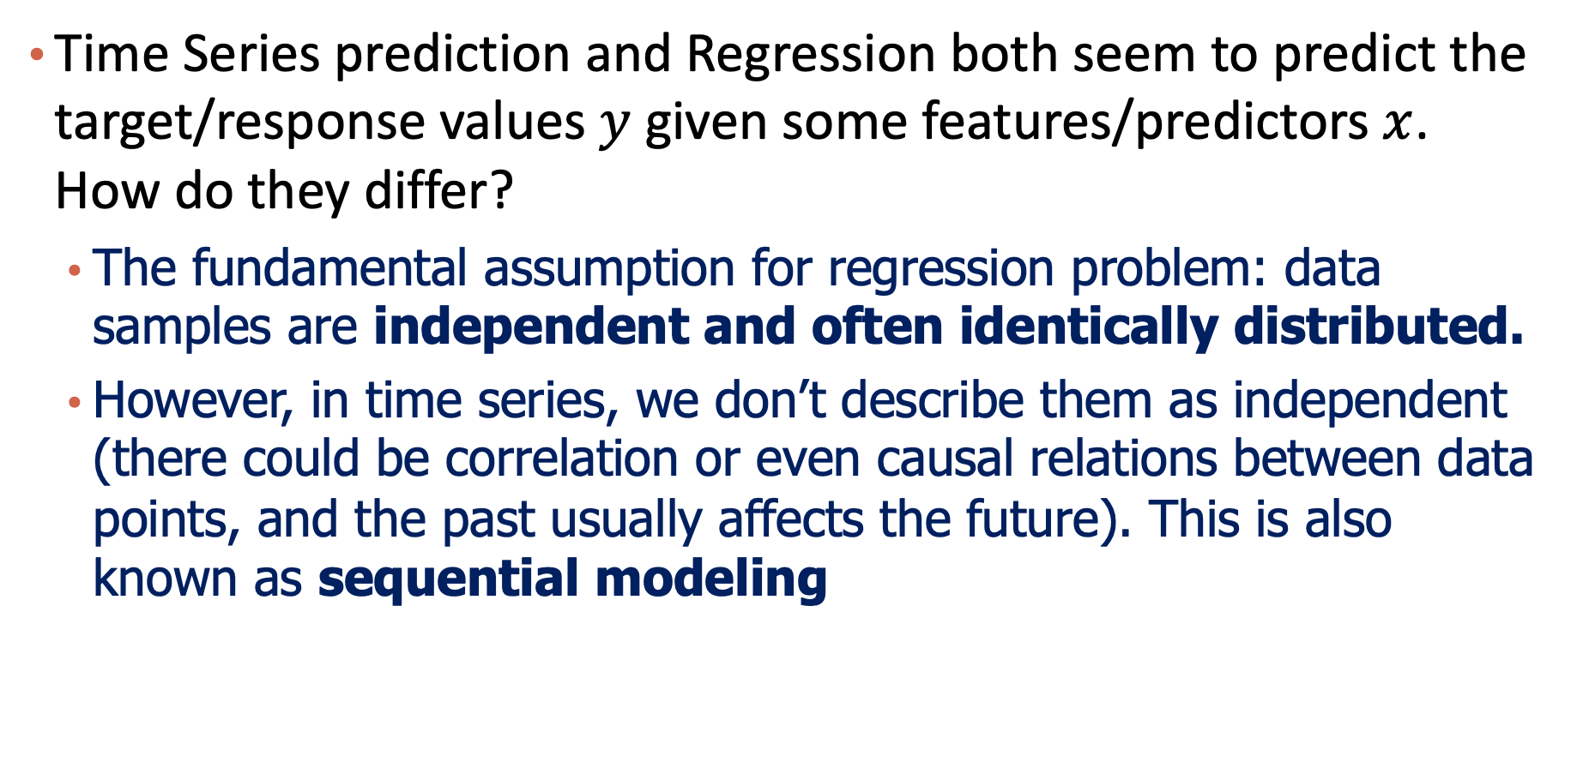
Comparison with Regression
Time Series prediction and Regression both seem to predict the target/response values $y$ given some features/predictors $x$. How do they differ?
The fundamental assumption for regression problem: data samples are independent and often identically distributed.
However, in time series, we don’t describe them as independent (there could be correlation or even causal relations between data points, and the past usually affects the future). This is also known as sequential modeling

Slide 20
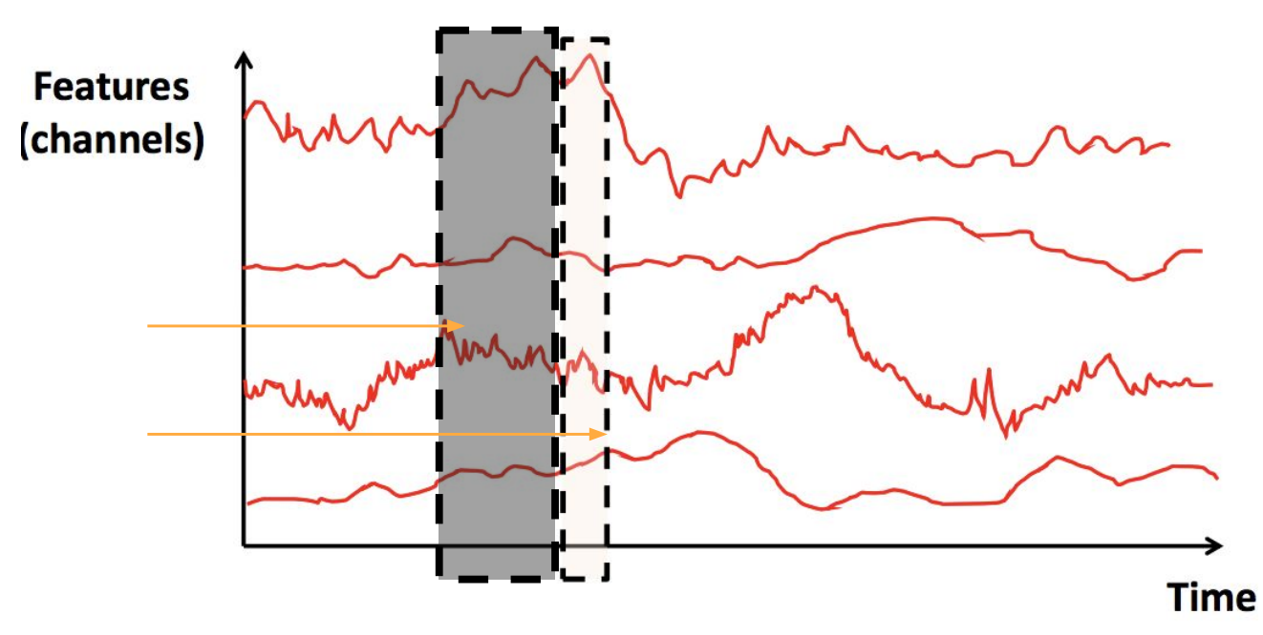
Problem Definition
Recall that we only use a small window size of past to predict future
Why use a look back window instead of the whole timeseries?
Model efficiency: feeding all historical data into the model may be out of memory, and the speed would be very slow.
Model performance: longer historical data does not necessarily yield for a better prediction performance (i.e., too much noise).
Look back window (observed period)
Prediction period

Slide 21
Roadmap
Introduction
Problem Definition
Data Acquirement and Visualization
Model Description & Evaluation
Visualization of Results

Slide 22
Data & Visualization
Data Description.
Prediction Goal:
We are interested in predicting the cumulative daily cases for all 50 states in the U.S. from April.1 to April.30,2021.
In other words, the model should output 50*30 values for cumulative cases corresponding to the 50 states in the 30 days.

Slide 23
Data & Visualization
Data Description.
Model Input: timeseries for 8 variables from Jan.12 – Mar.31 2021, and the static population data for each state.
Dynamic variables: Confirmed, Deaths, Recovered, Mortality Rate, Testing Rate, etc., with full description on JHU github
Static variable: state population from wiki.

Slide 24
Data & Visualization
Data Visualization
Raw Data Snapshot

Slide 25
Data & Visualization
Data Visualization
Timeseries Example: different features e.g. cases, deaths have different value ranges, thus requiring normalization.

Slide 26
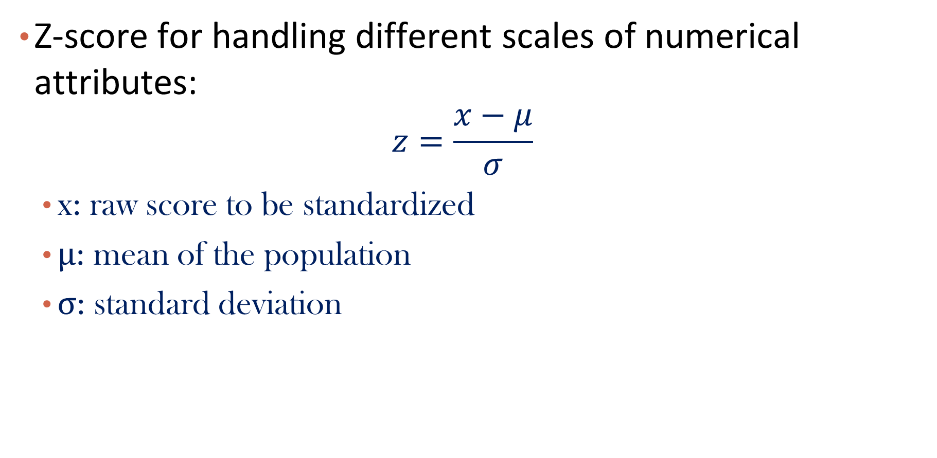
Data & Visualization
Z-score for handling different scales of numerical attributes:
$$z=\frac{x−μ}{σ}$$
x: raw score to be standardized
μ: mean of the population
σ: standard deviation

Slide 27
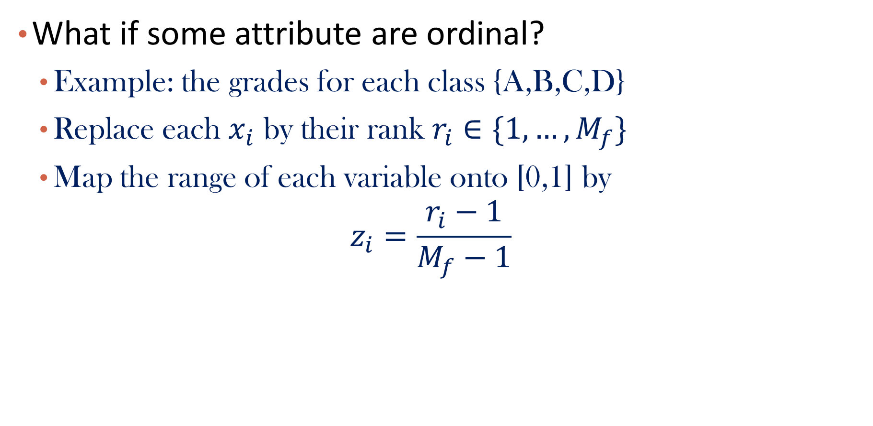
Data & Visualization
What if some attribute are ordinal?
Example: the grades for each class {A,B,C,D}
Replace each $x_{i}$ by their rank $r_{i}∈\{1,…,M_{f}\}$
Map the range of each variable onto [0,1] by
$$z_{i}=\frac{r_{i}−1}{M_{f}−1}$$

Slide 28
Data & Visualization
Data Visualization
Timeseries Example: sometimes we may not directly use the raw data as input, we may differentiate them first to make it stable. (to be discussed later)

Slide 29
Data & Visualization
Data Visualization
Timeseries Example:
We can build separate models to predict the deaths for each state independently.
However, the following figure shows that New Jersey tends to have more correlation with New York due to possible higher population flow among them. There are also models that make predictions for all states simultaneously.

Slide 30



Please download and install the Slido app on all computers you use
Audience Q&A Session
ⓘ Start presenting to display the audience questions on this slide.

Slide 31
Roadmap
Introduction
Problem Definition
Data Acquirement and Visualization
Model Description & Evaluation
Visualization of Results

Slide 32
Model Description
Autoregressive model -- AR ^{[1]}
Epidemic model -- SIR ^{[2]}
[1] http://people.cs.pitt.edu/~milos/courses/cs3750/lectures/class16.pdf
[2] https://covid19.uclaml.org/model.html

Slide 33
General Assumption: Stationary
Time series is difficult to predict as it is non-deterministic in nature, i.e. we cannot predict with certainty what will occur in the future. (in mathematics, these are called “stochastic processes”)
But the problem could be a little bit easier if the time series is stationary: you simply predict its statistical properties will be the same in the future as they have been in the past!
A stationary time series is one whose statistical properties such as mean, variance, etc. are all constant over time.
Not very realistic but could be a starting point.

Slide 34
General Assumption: Stationary
Stationary timeseries tends to be fluctuating around some fixed level.
In practice, a simple trick to achieve stationary is to differ the original timeseries. (i.e. compute the difference between t and t+1 for every t)

Slide 35
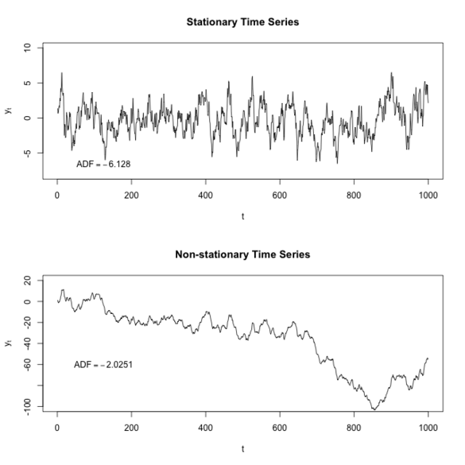
General Assumption: Stationary

Slide 36
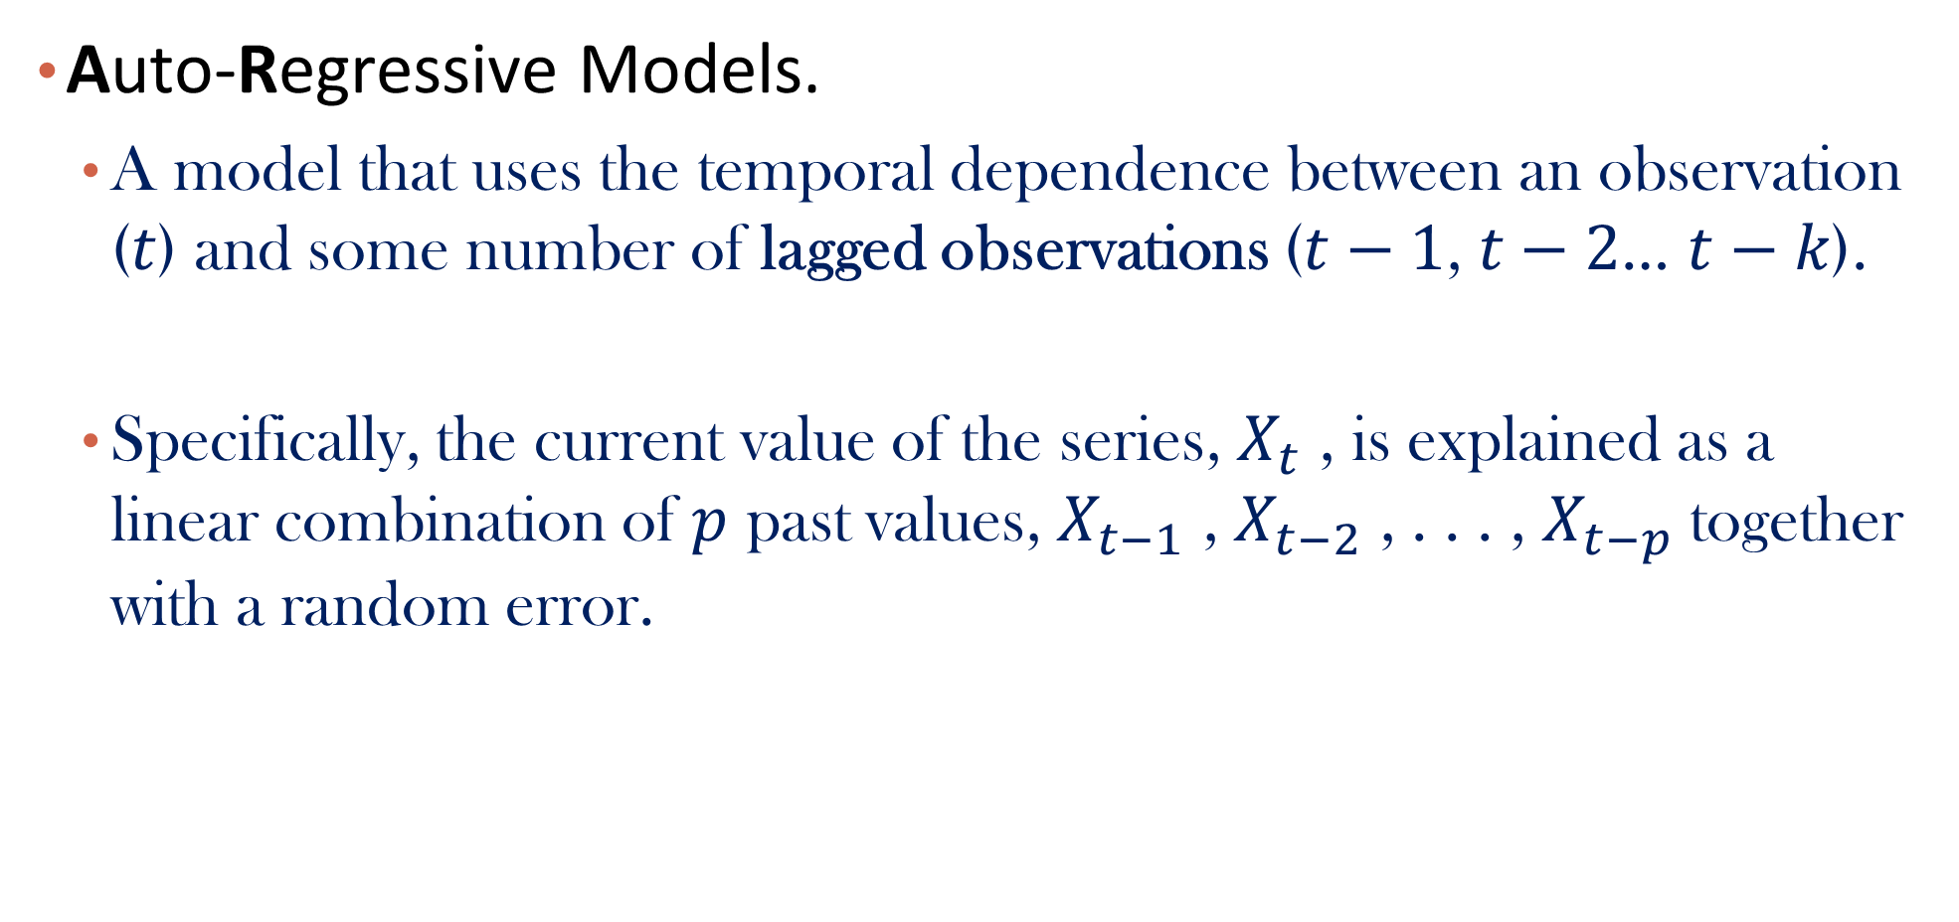
Autoregressive Models (AR)
Auto-Regressive Models.
A model that uses the temporal dependence between an observation ($t$) and some number of lagged observations ($t−1$, $t−2$… $t−k$).
Specifically, the current value of the series, $X_{t}$ , is explained as a linear combination of $p$ past values, $X_{t−1}$ , $X_{t−2}$ , . . . , $X_{t−p}$ together with a random error.
Notes:
Fib number

Slide 37
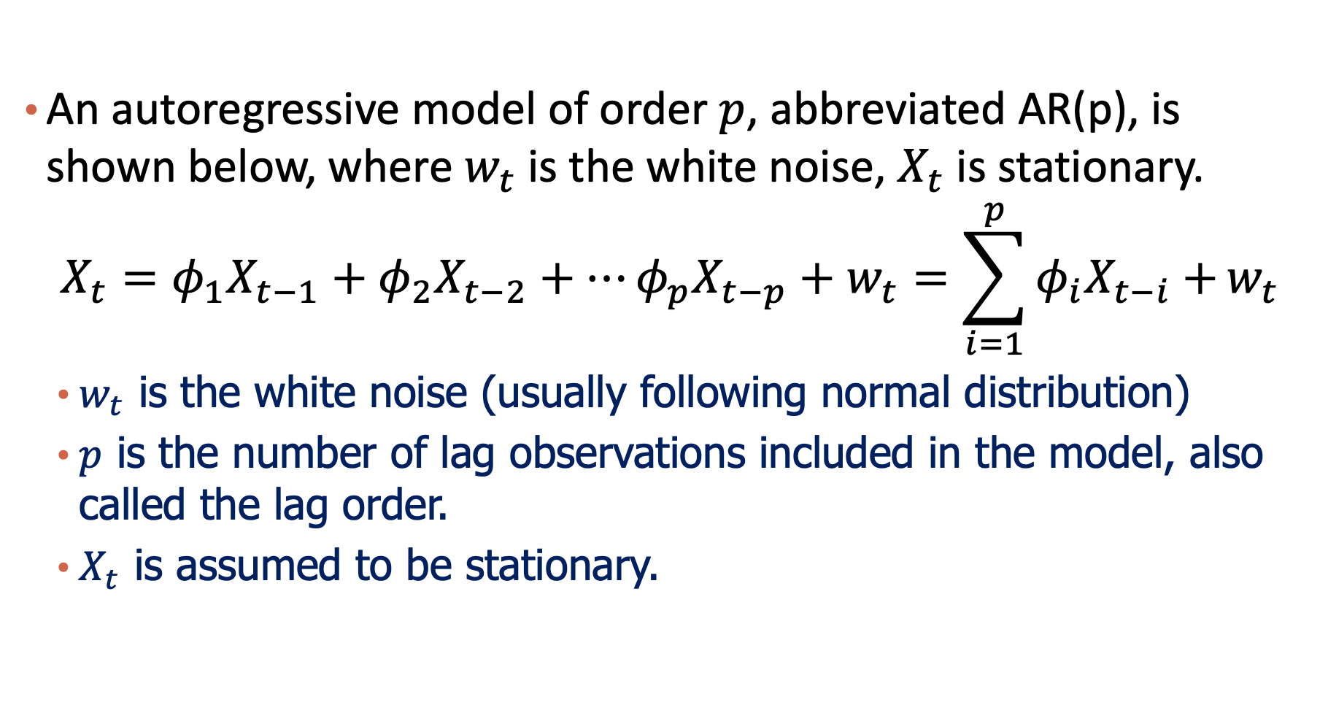
Autoregressive Models (AR)
An autoregressive model of order $p$, abbreviated AR(p), is shown below, where $w_{t}$is the white noise, $X_{t}$ is stationary.
$$X_{t}=φ_{1}X_{t−1}+φ_{2}X_{t−2}+…φ_{p}X_{t−p}+w_{t}=\sum_{i=1}^{p}{φ_{i}X_{t−i}+}w_{t}$$
$w_{t}$ is the white noise (usually following normal distribution)
$p$ is the number of lag observations included in the model, also called the lag order.
$X_{t}$ is assumed to be stationary.

Slide 38

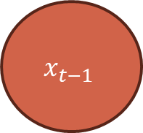

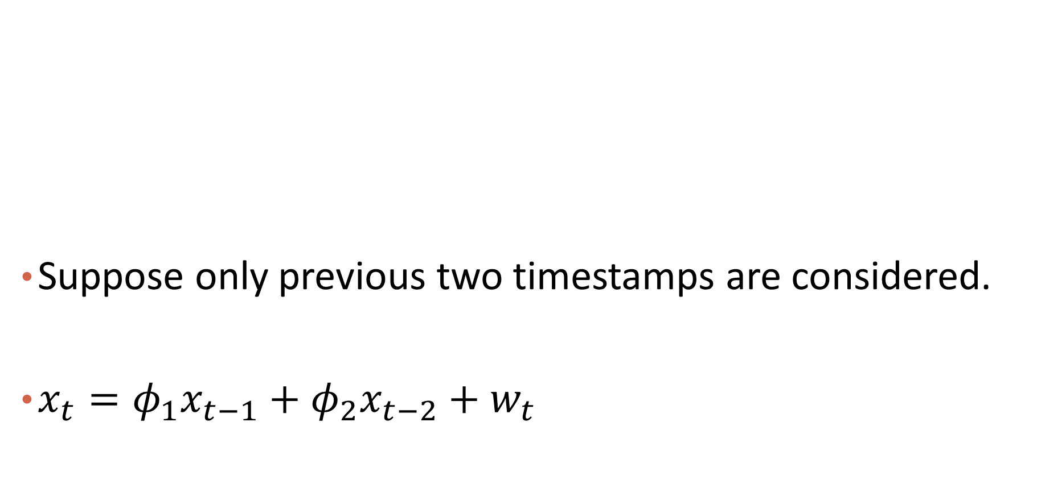
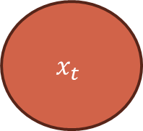
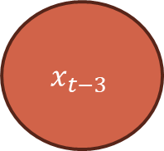
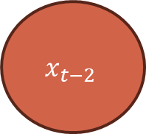

Autoregressive Model in Picture
Suppose only previous two timestamps are considered.
$x_{t}=φ_{1}x_{t−1}+φ_{2}x_{t−2}+w_{t}$
$$x_{t−3}$$
$$x_{t−2}$$
$$x_{t−1}$$
$$x_{t}$$
$$φ_{2}$$
$$φ_{1}$$
$$w_{t}$$

Slide 39
Autoregressive Models (AR)
AR Example: AR(1) Process

Slide 40
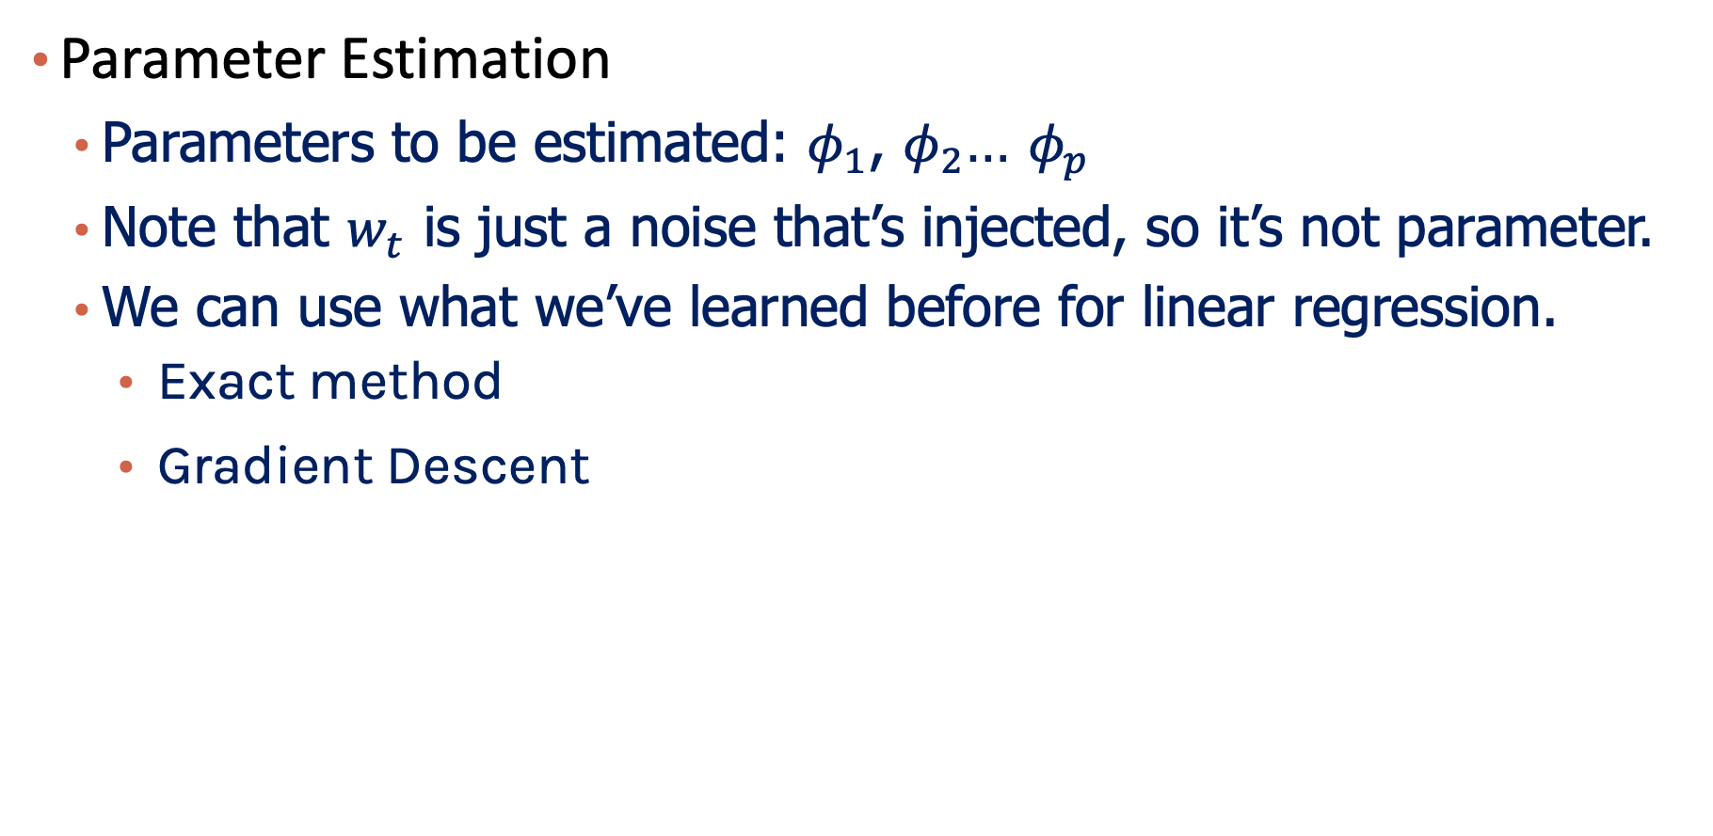
Autoregressive Models (AR)
Parameter Estimation
Parameters to be estimated: $φ_{1}$, $φ_{2}$… $φ_{p}$
Note that $w_{t}$ is just a noise that’s injected, so it’s not parameter.
We can use what we’ve learned before for linear regression.
Exact method
Gradient Descent

Slide 41
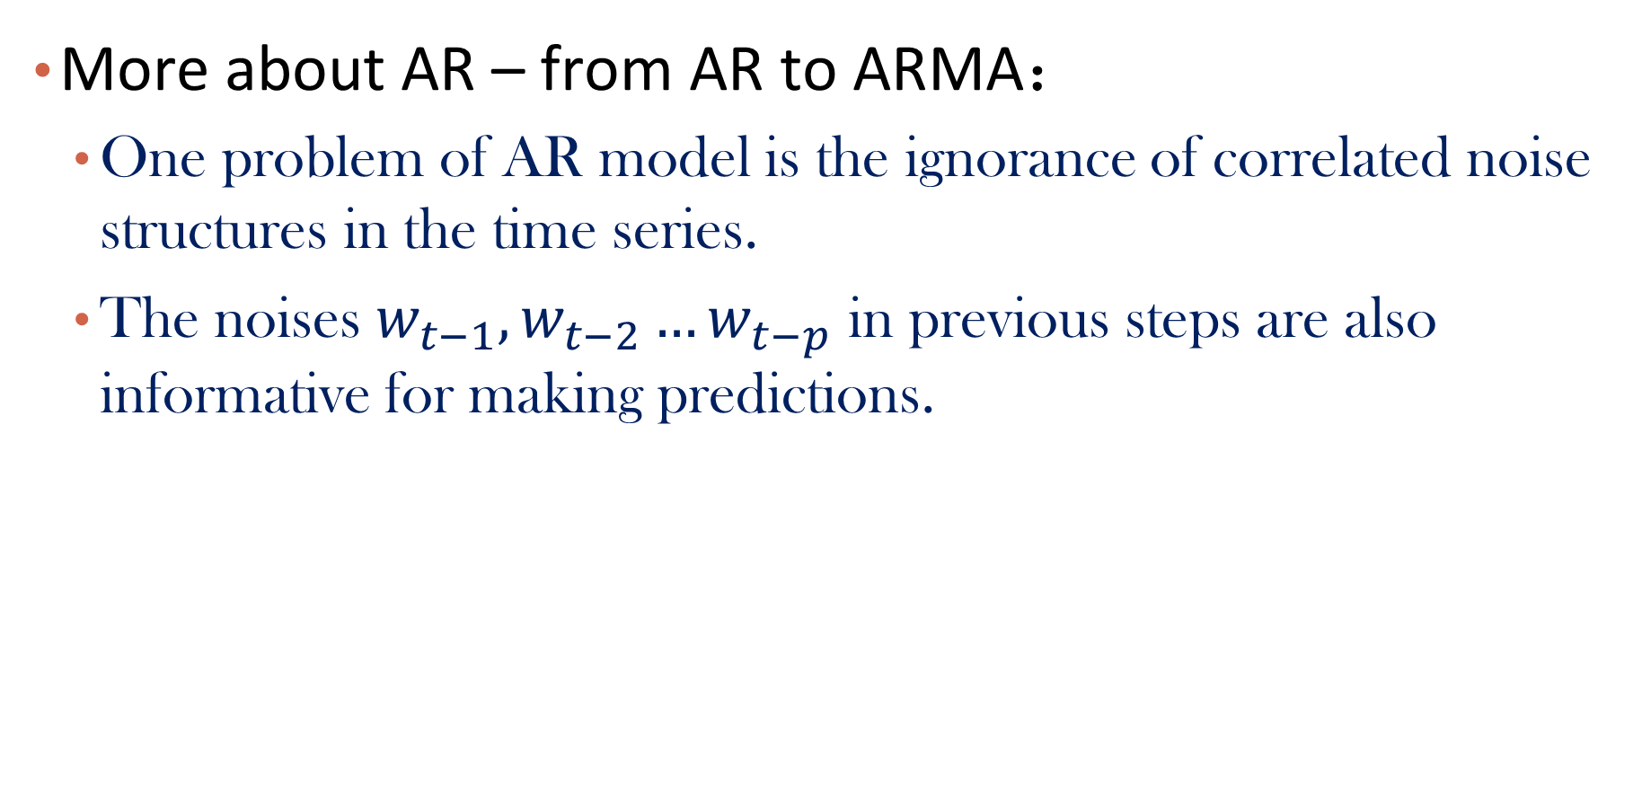
Autoregressive Model Moving Average (ARMA)
More about AR – from AR to ARMA：
One problem of AR model is the ignorance of correlated noise structures in the time series.
The noises $w_{t−1},w_{t−2}…w_{t−p}$ in previous steps are also informative for making predictions.

Slide 42
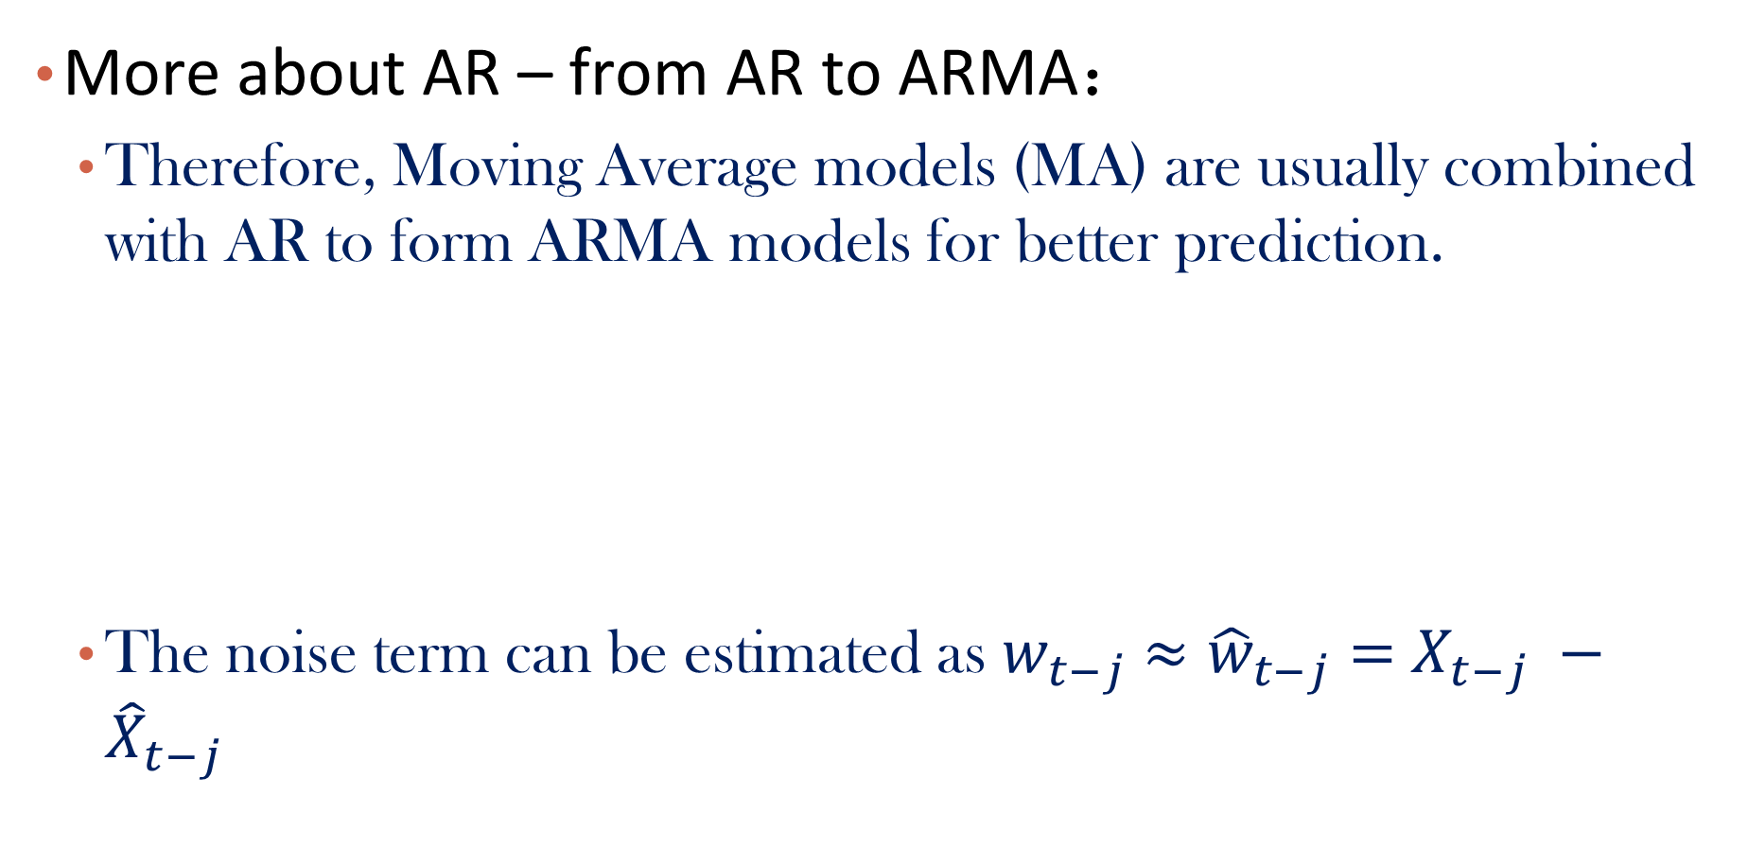
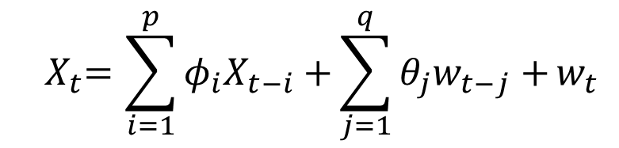
Autoregressive Model Moving Average (ARMA)
More about AR – from AR to ARMA：
Therefore, Moving Average models (MA) are usually combined with AR to form ARMA models for better prediction.
The noise term can be estimated as $w_{t−j}$ $≈{\hat{w}}_{t−j}=$ $X_{t−j} −{\hat{X}}_{t−j}$
$${ X}_{t}=\sum_{i=1}^{p}{φ_{i}X_{t−i}+}{\sum_{j=1}^{q}{θ_{j}w_{t−j}+}w}_{t}$$
AR model
MA model

Slide 43
Autoregressive Model Moving Average (ARMA)
More about AR – from AR to ARIMA：
If further combine ARMA with differencing operations as a whole, we get the ARIMA model, which is short for Auto-Regressive Integrated Moving Average.
A standard notation is ARIMA(p,d,q) where the parameters are substituted with integer values to quickly indicate the specific ARIMA model being used.
– p: The number of lag observations included in the model, also called the lag order.
– d: The number of times that the raw observations are differenced, also called the degree of differencing.
– q: The size of the moving average window, also called the order of moving average.

Slide 44
Autoregressive Model Moving Average (ARMA)
More about AR – from AR to ARIMA：
A value of 0 can be used for a parameter, which indicates to not use that element of the model.
More details can be found here.

Slide 45
Please download and install the Slido app on all computers you use
Audience Q&A Session
ⓘ Start presenting to display the audience questions on this slide.

Slide 46
Model Description
Autoregressive model -- AR ^{[1]}
Epidemic model -- SIR ^{[2]}
[1] http://people.cs.pitt.edu/~milos/courses/cs3750/lectures/class16.pdf
[2] https://covid19.uclaml.org/model.html

Slide 47
Epidemic Model -SIR
SIR is an epidemic model developed in early 20th century^{[1,2]} .
Consider a closed environment of 𝑁 individuals, SIR considers each individual as one of the following:
Susceptible: not yet infected, disease-free
Infected: infected and infectious
Recovered: recovered and would never be infected again (lifelong immunity)
[1] https://covid19.uclaml.org/model.html
[2] https://en.wikipedia.org/wiki/Compartmental_models_in_epidemiology#The_SIR_model

Slide 48
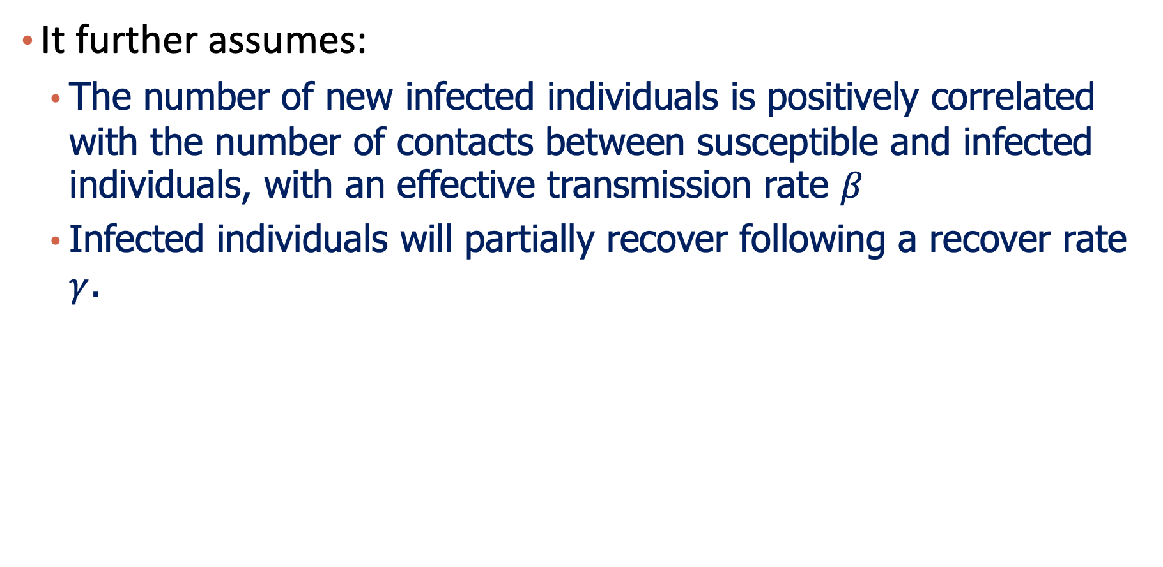
Epidemic Model -SIR
It further assumes:
The number of new infected individuals is positively correlated with the number of contacts between susceptible and infected individuals, with an effective transmission rate 𝛽
Infected individuals will partially recover following a recover rate $γ$.
[1] https://covid19.uclaml.org/model.html
[2] https://en.wikipedia.org/wiki/Compartmental_models_in_epidemiology#The_SIR_model

Slide 49
Epidemic Model -SIR
It further assumes:
Transmission and removal rates are constant.
Constant (closed) population size and well-mixed population.
No birth and death.
[1] https://covid19.uclaml.org/model.html
[2] https://en.wikipedia.org/wiki/Compartmental_models_in_epidemiology#The_SIR_model

Slide 50
Epidemic Model -SIR
The following figure shows the dynamic interplay among the susceptible individuals (S), infectious individuals (I) and recovered/deceased individuals (R) in a certain place with total popualtion of N.
[1] https://covid19.uclaml.org/model.html
[2] https://en.wikipedia.org/wiki/Compartmental_models_in_epidemiology#The_SIR_model

Slide 51
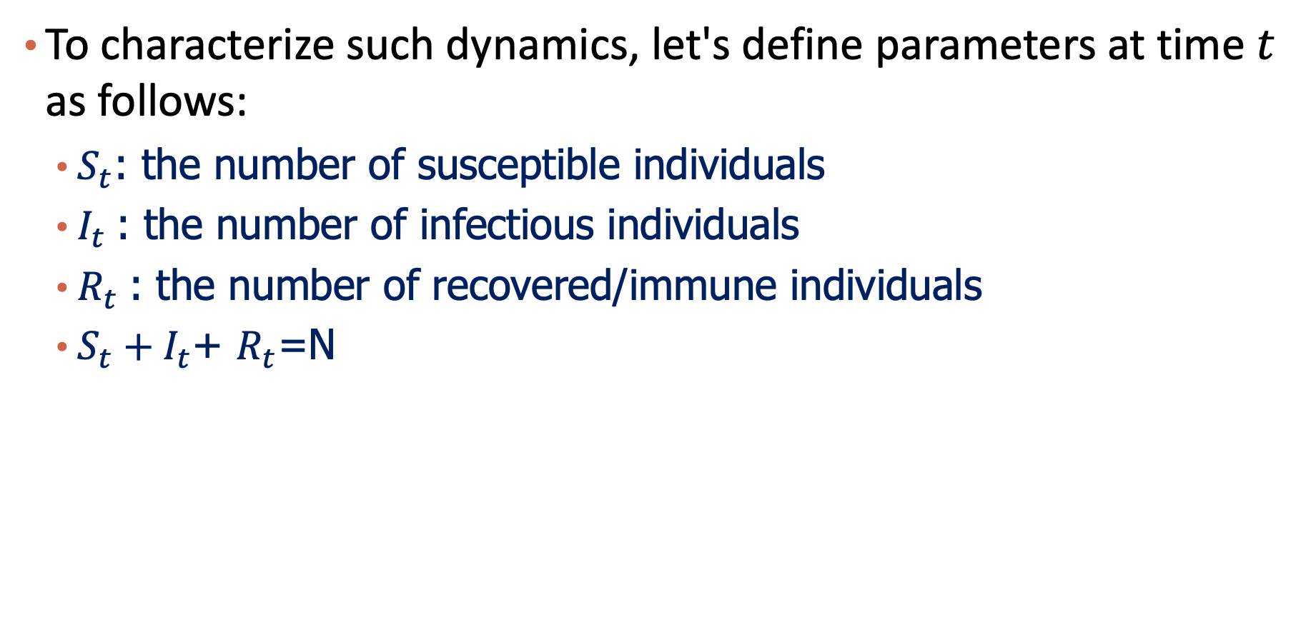
Epidemic Model -SIR
To characterize such dynamics, let's define parameters at time $t$ as follows:
$S_{t}$: the number of susceptible individuals
$I_{t}$: the number of infectious individuals
$R_{t}$: the number of recovered/immune individuals
$S_{t}+I_{t}$+ $R_{t}$=N
[1] https://covid19.uclaml.org/model.html
[2] https://en.wikipedia.org/wiki/Compartmental_models_in_epidemiology#The_SIR_model

Slide 52
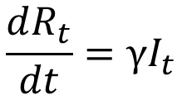
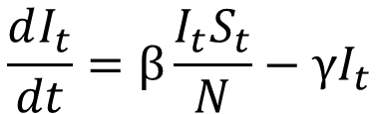
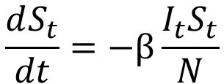
Epidemic Model -SIR
The evolving (differential) equations of the above parameters over time are defined as the follows:
$$\frac{dS_{t}}{dt}=−β\frac{I_{t}S_{t}}{N}$$
$$\frac{dI_{t}}{dt}=β\frac{I_{t}S_{t}}{N}−γI_{t}$$
$$\frac{dR_{t}}{dt}=γI_{t}$$

Slide 53
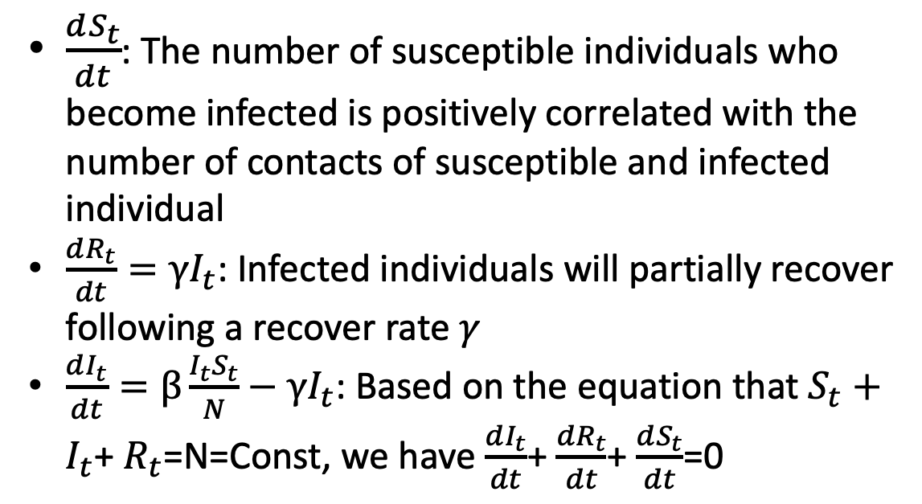
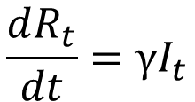
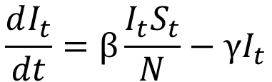
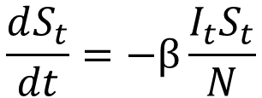
Epidemic Model -SIR
Interpretation:
$\frac{dS_{t}}{dt}$: The number of susceptible individuals who become infected is positively correlated with the number of contacts of susceptible and infected individual
$\frac{dR_{t}}{dt}=γI_{t}$: Infected individuals will partially recover following a recover rate $γ$
$\frac{dI_{t}}{dt}=β\frac{I_{t}S_{t}}{N}−γI_{t}$: Based on the equation that $S_{t}+I_{t}$+ $R_{t}$=N=Const, we have $\frac{dI_{t}}{dt}$+ $\frac{dR_{t}}{dt}$+ $\frac{dS_{t}}{dt}$=0
$$\frac{dS_{t}}{dt}=−β\frac{I_{t}S_{t}}{N}$$
$$\frac{dI_{t}}{dt}=β\frac{I_{t}S_{t}}{N}−γI_{t}$$
$$\frac{dR_{t}}{dt}=γI_{t}$$

Slide 54
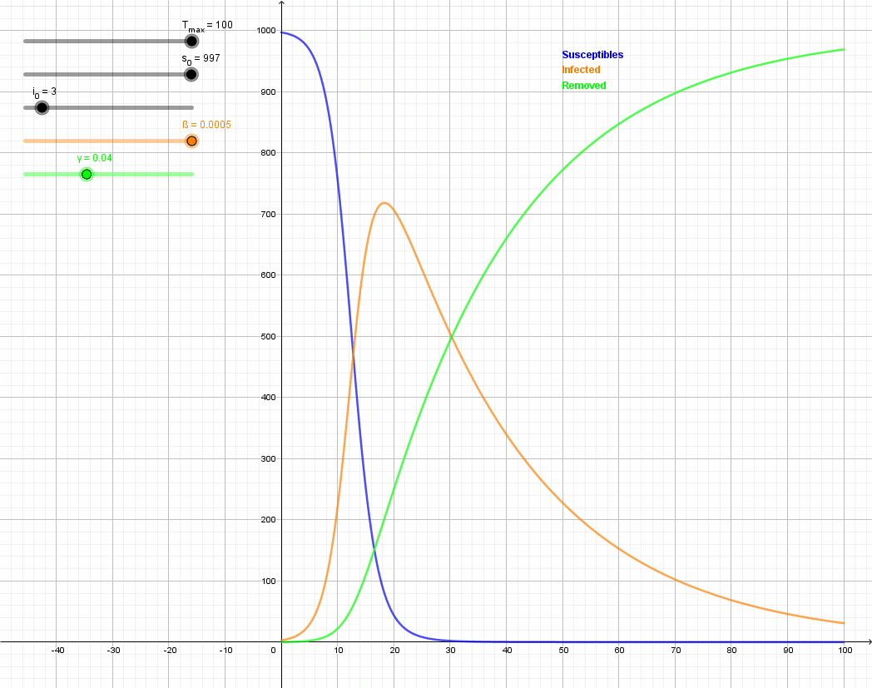
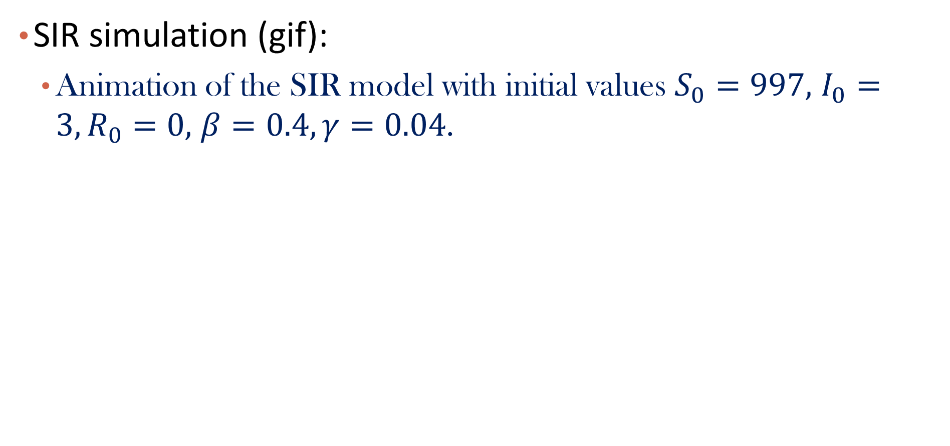
Epidemic Model -SIR
SIR simulation (gif):
Animation of the SIR model with initial values $S_{0}=997,$ $I_{0}=3,R_{0}=0,$ $β=0.4,γ=0.04$.

Slide 55
Epidemic Model -SIR
Can SIR predicts the number of deaths?
Though one assumption of SIR is that population is constant and typically no deaths, people usually employ a simple linear model for approximating the fatality rate. Given the predicted cases and the estimated fatality rate, the predicted number of deaths is just the production of them.

Slide 56
Epidemic Model -SIR
Parameter Learning:
Gradient based methods with the following loss function, where λ is a tunable hyper-parameter in order to balance the importance between the prediction error in terms of the infected cases and recovered cases.

Slide 57
SIR Variants
The assumptions made by SIR are very strong and differ from real-world scenarios. Therefore, a lot of variants have been proposed with more realistic assumptions.
Two major variant categories:
Adding more intermediate states: SEIR, SuEIR, etc
Making more realistic assumptions about parameters
Dynamic transmission/recover rate

Slide 58
Please download and install the Slido app on all computers you use
Audience Q&A Session
ⓘ Start presenting to display the audience questions on this slide.

Slide 59
*RNN for Time Series
Why RNNs?
Humans don’t start their thinking from scratch every second. As you read an essay, you understand each word based on your understanding of previous words. You don’t throw everything away and start thinking from scratch again. Your thoughts have persistence.
Traditional neural networks can’t do this, and it seems like a major shortcoming.
For example, imagine you want to classify what kind of event is happening at every point in a movie. It’s unclear how a traditional neural network could use its reasoning about previous events in the film to inform later ones.

Slide 60
*RNN for Time Series
Why RNNs?
RNNs are proposed to address this issue. They are networks with loops in them, allowing information to persist.
Long Short Term Memory Networks
A special types of RNN that can handle (to some extend) long-term dependencies.
https://colah.github.io/posts/2015-08-Understanding-LSTMs/

Slide 61
Roadmap
Introduction
Problem Definition
Data Acquirement and Visualization
Model Description & Evaluation
Visualization of Results

Slide 62
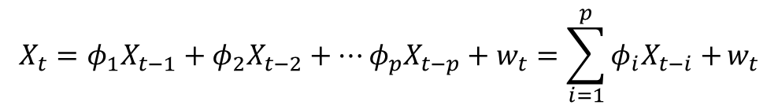
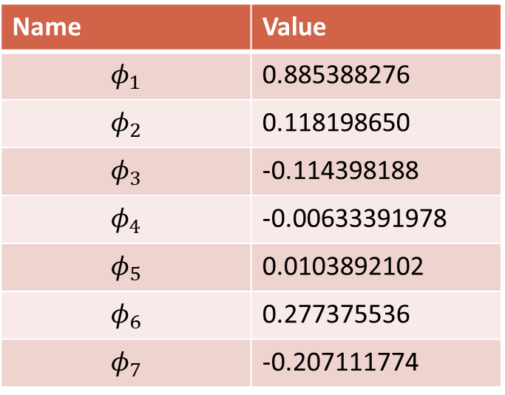
Visualization of Results
AR model ^{[1]}
$$X_{t}=φ_{1}X_{t−1}+φ_{2}X_{t−2}+…φ_{p}X_{t−p}+w_{t}=\sum_{i=1}^{p}{φ_{i}X_{t−i}+}w_{t}$$
Learned Coefficients for “Alabama - Confirmed” (p=7)
Name | Value
$$φ_{1}$$ | 0.885388276
$$φ_{2}$$ | 0.118198650
$$φ_{3}$$ | -0.114398188
$$φ_{4}$$ | -0.00633391978
$$φ_{5}$$ | 0.0103892102
$$φ_{6}$$ | 0.277375536
$$φ_{7}$$ | -0.207111774
[1] https://github.com/mrcolo/cs145covid

Slide 63
Visualization of Results
SIR model^{[1]}
Cases Prediction in CA
Deaths Prediction in CA, by fitting a function to produce fatality rate
[1] https://github.com/rosie068/CS145_S21_project

Slide 64
Roadmap
Epidemics Modeling
Introduction: COVID-19 Case Prediction
Time Series Prediction: Problem Definition
Data Acquirement and Visualization
Model Description
Auto-Regressive Modeling
SIR for epidemic Modeling
Visualization of Results
Financial Market Modeling
Financial Time Series
Mechanism-driven vs. Data-Driven methods
Laws of Physics vs. Machine Learning
The Financial Epidemics and Market Contagion

Slide 65
Time Series Modeling in Financial Market
The Financial Market provides lots of time series:
Commodity Price
Interest Rates, Mortgage Rates, etc.
Bond Price
Stock Price
Price of Derivatives (Futures, Options, etc.)

Slide 66

Moreover, Big Data
WRDS democratizes data access so that all disciplines, Accounting, Banking, Economics, ESG, Finance, Healthcare, Insurance, Marketing, and Statistics, can easily search for concepts across the data repository. Partnering with global vendors, WRDS hosts 350+TB of data — the broadest collection of data on the most robust computing infrastructure to give users the power to analyze complex information at speeds of up to 400MB per second.

Slide 67
Financial Market Modeling Can be Difficult
Randomness plays a stronger role, compared to the epidemics modeling
Government regulations
The Human factor (over-reaction, avoidance of pain, even trolling…)
Events with Small Probabilities but Great Impacts (i.e., the Black Swans) (think about how events like COVID-19 affect the market, and you cannot predict COVID-19 happening)
Liquidity (Algorithmic Trading at high frequency)

Slide 68
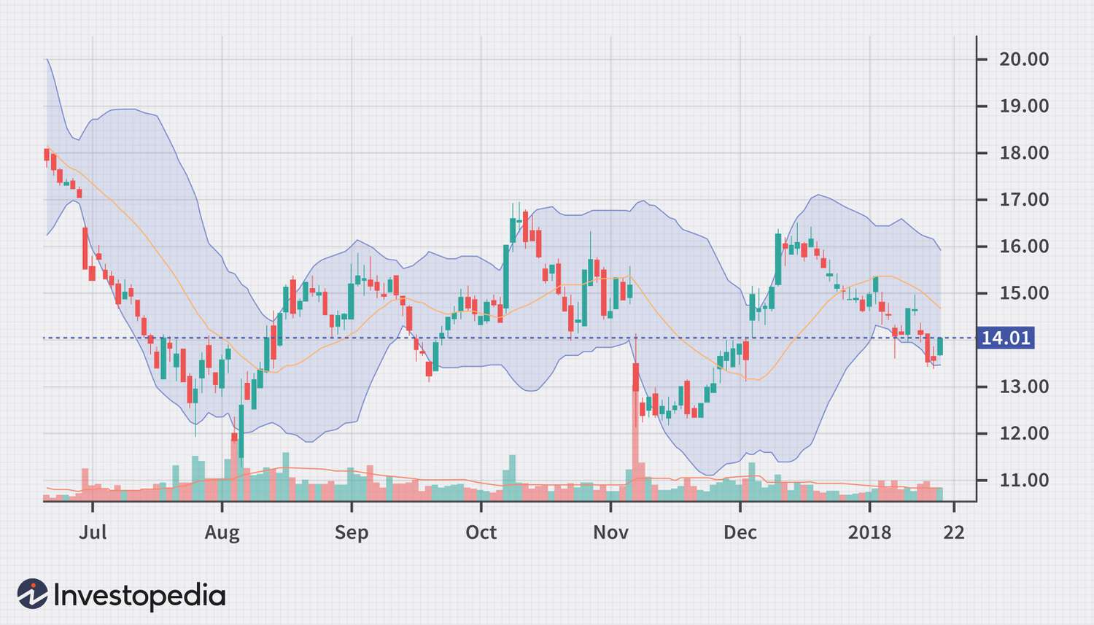
Financial Market Modeling Can be Difficult
Is the following stationary?

Slide 69
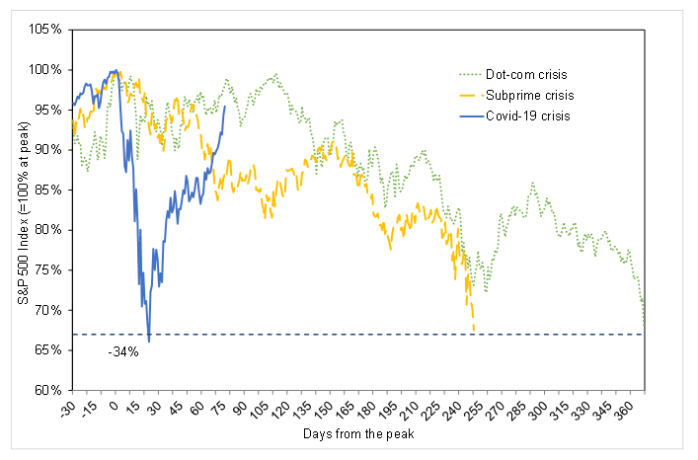
Financial Market Modeling Can be Difficult
Does History repeat and does it rhyme?

Slide 70
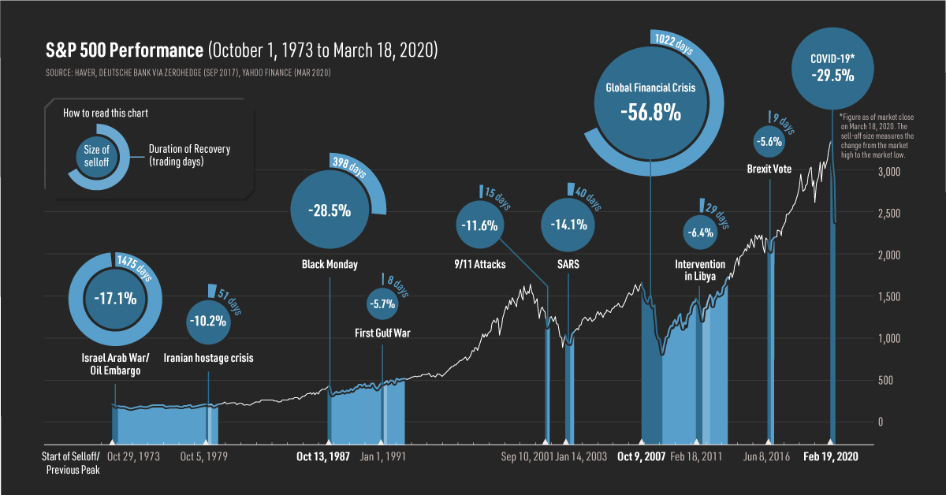
The “Random” Factor

Slide 71
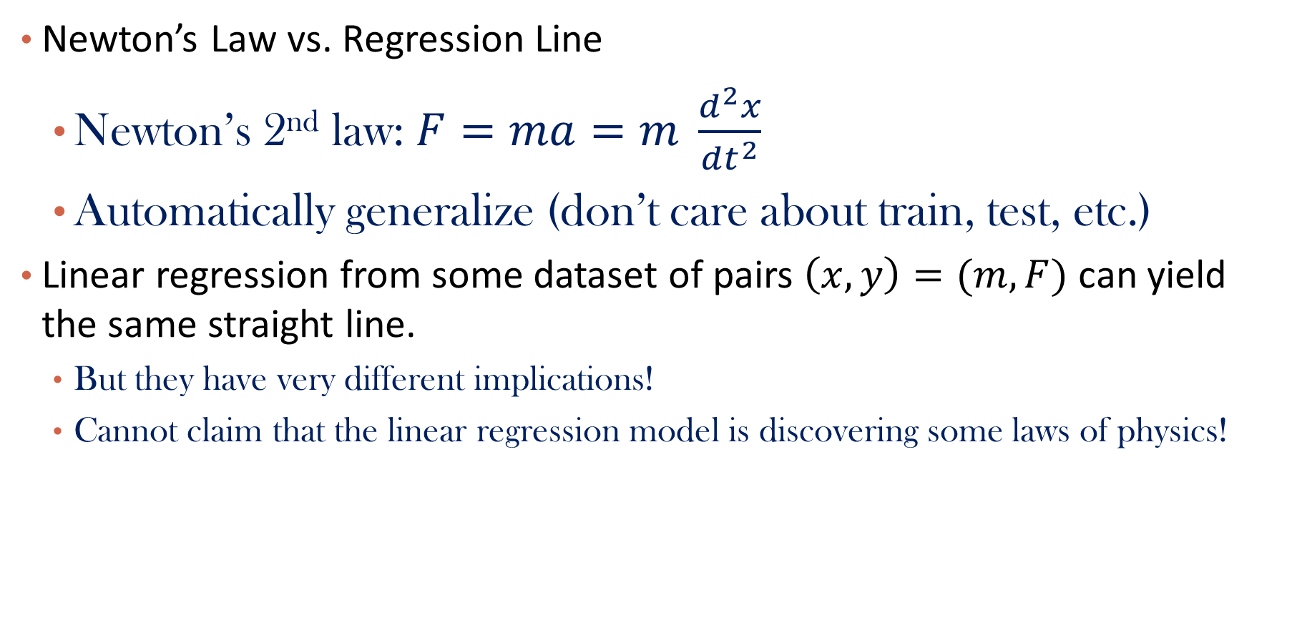
Return to “Regression”
Newton’s Law vs. Regression Line
Newton’s 2nd law: $F=ma=m \frac{d^{2}x}{dt^{2}}$
Automatically generalize (don’t care about train, test, etc.)
Linear regression from some dataset of pairs $\left(x,y\right)=(m, F)$ can yield the same straight line.
But they have very different implications!
Cannot claim that the linear regression model is discovering some laws of physics!

Slide 72
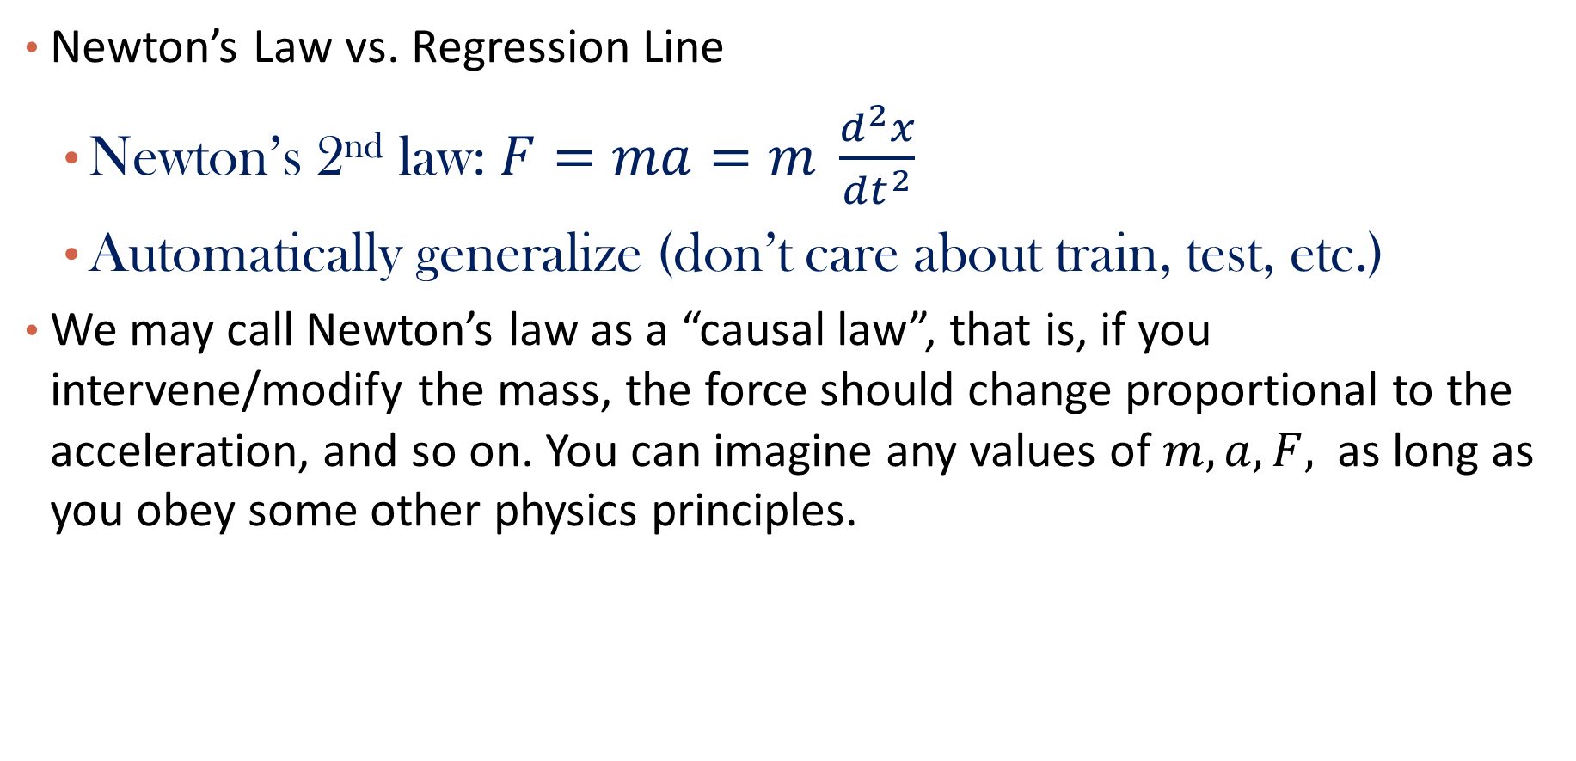
Return to “Regression”
Newton’s Law vs. Regression Line
Newton’s 2nd law: $F=ma=m \frac{d^{2}x}{dt^{2}}$
Automatically generalize (don’t care about train, test, etc.)
We may call Newton’s law as a “causal law”, that is, if you intervene/modify the mass, the force should change proportional to the acceleration, and so on. You can imagine any values of $m, a, F,$ as long as you obey some other physics principles.

Slide 73
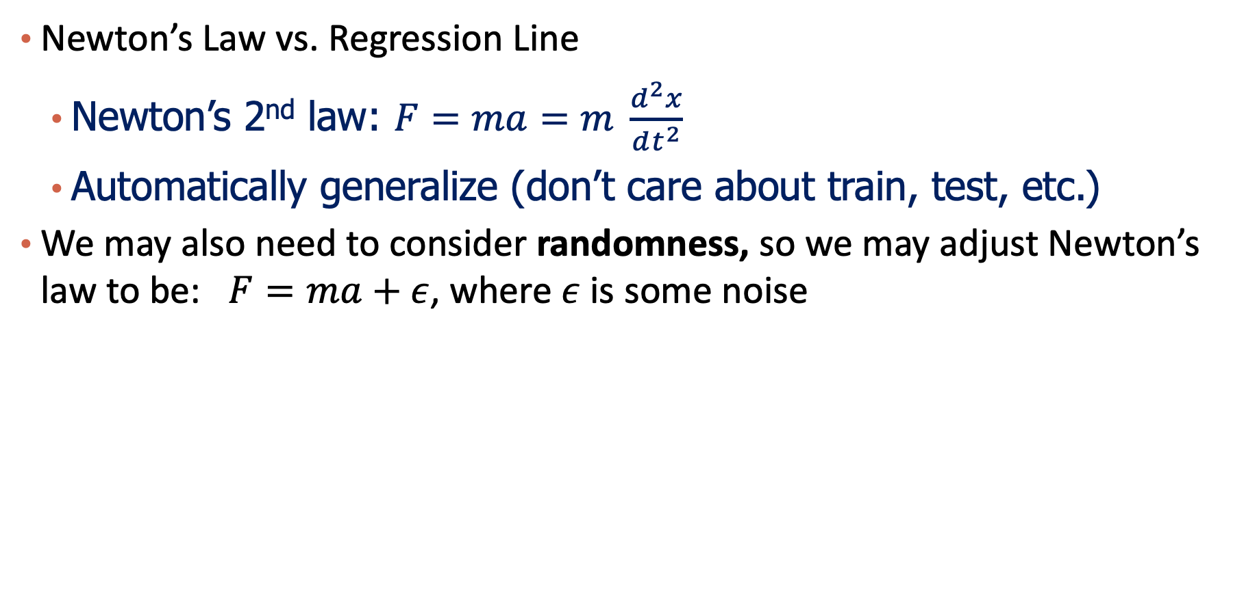
Return to “Regression”
Newton’s Law vs. Regression Line
Newton’s 2nd law: $F=ma=m \frac{d^{2}x}{dt^{2}}$
Automatically generalize (don’t care about train, test, etc.)
We may also need to consider randomness, so we may adjust Newton’s law to be: $F=ma+ε$, where $ε$ is some noise

Slide 74
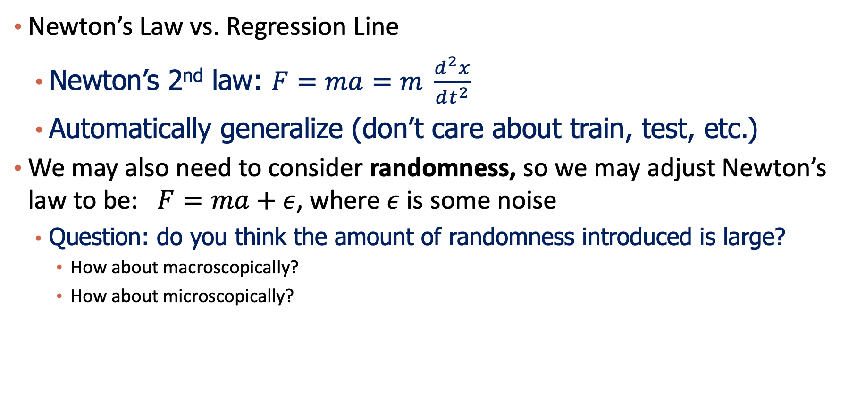
Return to “Regression”
Newton’s Law vs. Regression Line
Newton’s 2nd law: $F=ma=m \frac{d^{2}x}{dt^{2}}$
Automatically generalize (don’t care about train, test, etc.)
We may also need to consider randomness, so we may adjust Newton’s law to be: $F=ma+ε$, where $ε$ is some noise
Question: do you think the amount of randomness introduced is large?
How about macroscopically?
How about microscopically?

Slide 75
AR vs. Deep Learning
Data-driven methods vs. Mechanism-driven methods
We have seen this tension in many scenarios:
Deep learning methods are completely driven by data, with some generic schematics
Mechanism-based methods (ARMA, SIR, even Newton’s Laws) usually provide a mechanistic explanation of “how” and “why”.
Which one is better?
A very difficult question to answer
Data driven methods can be more precise and accurate for particular applications
Mechanism-based methods usually generalize better, but they can have unrealistic assumptions.
There’s an evolving discipline in machine learning, called physics-driven machine learning, which may have the potential to combine both.

Slide 76
Learning vs. Physics Law
Can a deep learning model construct laws like Newton and Kepler? (Not yet)
Neural networks are black boxes, and they don’t form elegant “laws” automatically
Many recent works (“neural-symbolic regression”, “physics-informed machine learning”) trying to address this issue
Question: is time series prediction a well-defined problem?
Do we want to understand the law or do we just want a predictive model ?

Slide 77
A short detour to COVID-19 Modeling
If the data doesn’t contain anything post the approval of the vaccine, can the model infer about/predict the invention of vaccine?
Again, a shortcoming of data-driven methods (the model has to see some similar/same patterns before)
But history is full of surprises!

Slide 78
Return to Financial Market
“Physics laws” in this case refer to:
Geometric Brownian Motion
The Black-Sholes Formula
Dupire’s Equation
“Financial Economics”
Market Microstructure
Etc.
Still a mystery the validity of these “economic laws”

Slide 79
From Epidemics to Financial Market
Is there “epidemics” for financial market?
What happened in 2008?
Financial Contagion: some large banks went bankrupt
Some of their clients go bankrupt.
Great Un-employments
Downward Spiral…
SIR model for Financial Contagion
If the Government has a good idea of the spread of financial contagion, more effective regulations can be enforced.

Slide 80
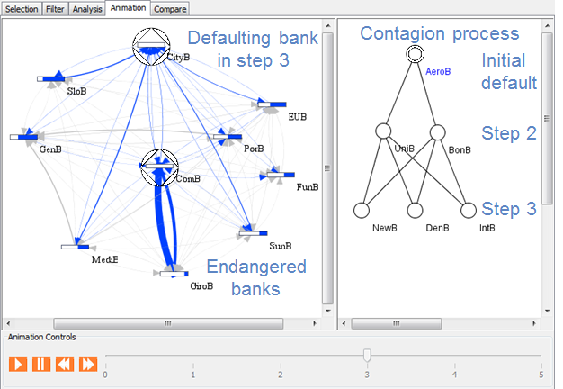
Financial network and contagion
TU Darmstadt

Slide 81
Summary
We have learned time series modeling and its application in:
Epidemics Modeling
Financial Market Modeling
In all these scenarios (and many other fields, as you will learn in the future), there is a trend of combining machine learning methods with “mechanism-driven” methods:
This can be the future of time series modeling.
Moreover, we could have “AI economists” and “AI physicists” in the future that can produce both predictive models and scientific laws.

